Slide 1
RAID
Redundancy with common disks
Notes:
Articles on the internet:
http://www.pcmag.com/article2/0,2817,2370235,00.asp

Slide 2
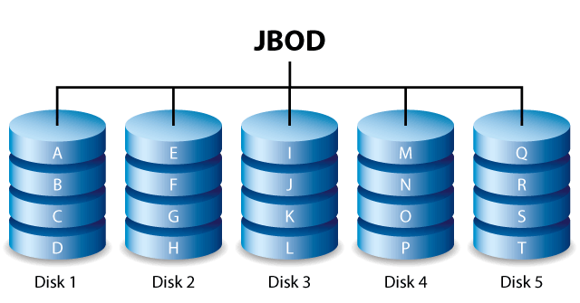
JBOD – Just a Bunch Of Disks

Slide 3
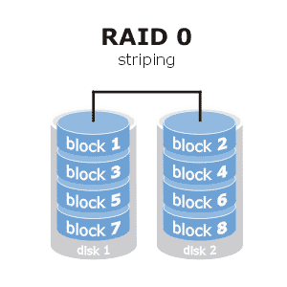
RAID 0
Redundant Array of Independent (or Inexpensive) Disks
RAID 0: Striping,
secure against single theft, ( how much data does the thief have …?)
unsecure against hardware failure

Slide 4
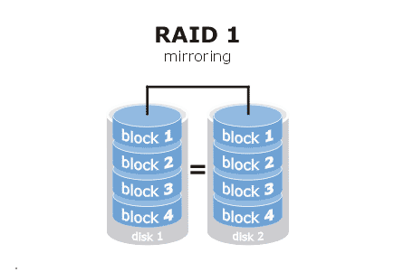
RAID 1
RAID 1: Mirroring (using 2 or more disks)
Safe against hardware failure, COMPLETELY unsafe against theft
When using RAID 1: use volume encryption (e.g. bitlocker …)
Hot Spare disk == idle disk that has spun down, if needed a rebuild action can start automatically

Slide 5
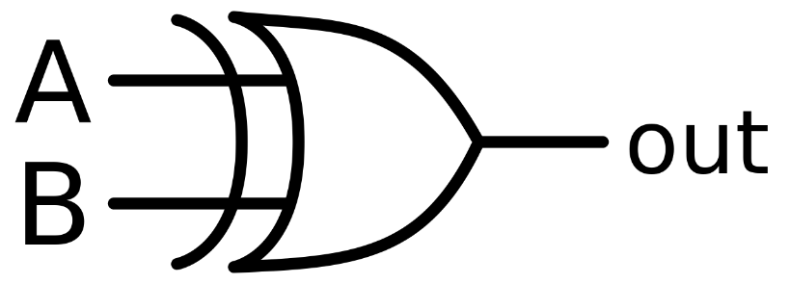
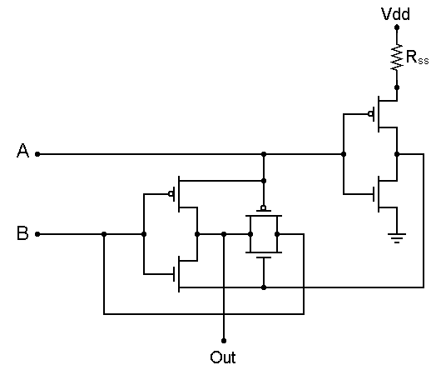
Parity calculations: XOR
Basic XOR calculation: data1: 001 data2: 100 parity: 101
Data1 get’s lost … use parity to recover: data2: 100 parity: 101 recovered: 001
Exercise: calculate the parity of 0110 and 0101 loose 0110, and recover using the parity
A | B | XOR
0 | 0 | 0
0 | 1 | 1
1 | 0 | 1
1 | 1 | 0

Slide 6
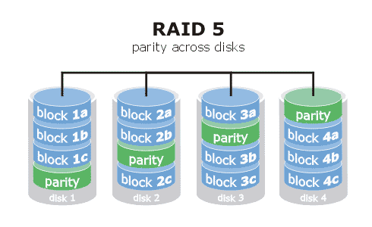
RAID 5
Parity, at least three disks needed. Always one disk lost for capacity.
If one disk fails, we are left with a RAID 0 alike operation.
If Hot Spare is configured, rebuild action starts immediately (bigger load on remaining disks!)
Current (fast) processors make RAID 5 as fast as RAID 1 or better

Slide 7
Parity calculations: XOR on 4 disks
A | B | XOR
0 | 0 | 0
0 | 1 | 1
1 | 0 | 1
1 | 1 | 0
Basic XOR calculation: block1a: 0010 block2a: 1001 parity-temp: 1011 block3a: 1100 parity: 0111
Block2a get’s lost … use parity to recover: block3a: 1100 parity: 0111 parity-temp: 1011 block1a: 0010 recovered: 1001

Slide 8
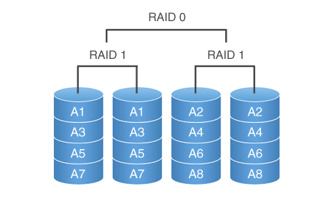
RAID 10
At least 4 disks are needed, capacity is cut in half.
Very frequently used by enterprises
Read like this: RAID 1 (mirror) + RAID 0 (stripe)
Notes:
Exercise: 6 Disk RAID 10 (3 disk RAID 1) redundancy factor?

Slide 9
Soft- or Hardware RAID ?
Difference: where are the RAID calculations taking place?
Hardware RAID: dedicated RAID Chip (onboard or plugin card)
Software RAID: shared processor (usually CPU)
If working with DAS¹ systems: hardware RAID has not much use!
Main CPU is more than strong enough (if not stronger) for added RAID functionality.
Recovery is easier with Software RAID (forensic analysis!)
With SAN / NAS there usually is not much choice: dedicated RAID controller with proprietary algorithms.
¹DAS: Directly Attached Storage

Slide 10
The big problem with Hardware RAID
Besides the algorithms and protocols being proprietary and therefor very difficult to recover in case of data loss or forensic research!
Every (good) RAID controller duplicates RAID configuration on the disks for recovery purposes, however: no standard
However: RAID Controllers are also aging
E.g. RAID 10 on Areca RAID Controller is not recognized if the disks are connected to a Adaptec RAID Controller!
OR: RAID 10 on Areca RAID bought 5 years ago, not recognized in recent Areca RAID.
Hence the Single Point of Failure with Hardware RAID: the RAID controller!

Slide 11
Software RAID
Can be done by the OS itself Windows Dynamic Volumes or Storage Spaces or Linux soft raid or Logical Volumes or by extra software (e.g. Starwind)
Usually easy expandable
Recoverable (usually backwards compatible)
“Free” (included in OS)
Works independently of interface (IDE, SATA, SAS, SCSI …)
Fast (uses modern, powerful CPUs)
However, OS not easy to install onto software RAID
Not all RAID levels are possible
Hot Swap not always supported (depends interface protocol configuration)

